Slide 1
Science will not solve the Problems
The urgent need for an ecological conversion and the challenge to shape the transition to the benefit of everybody
University of Natural Resources and Life Sciences, Vienna
Institute of Meteorology and Climatology and
Center for Global Change and Sustainability em. Univ. Prof. Dr. Helga Kromp-Kolb

Slide 2
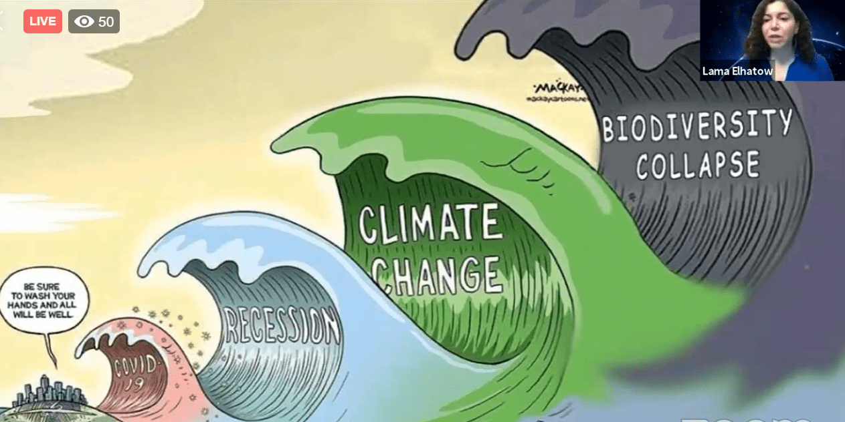
Multiple crises: all man (self) made!
An outsider looking at our world would be amazed at such behaviour, which at times appears self-destructive. (Laudato Si!; 55)
Armed Conflicts

Slide 3
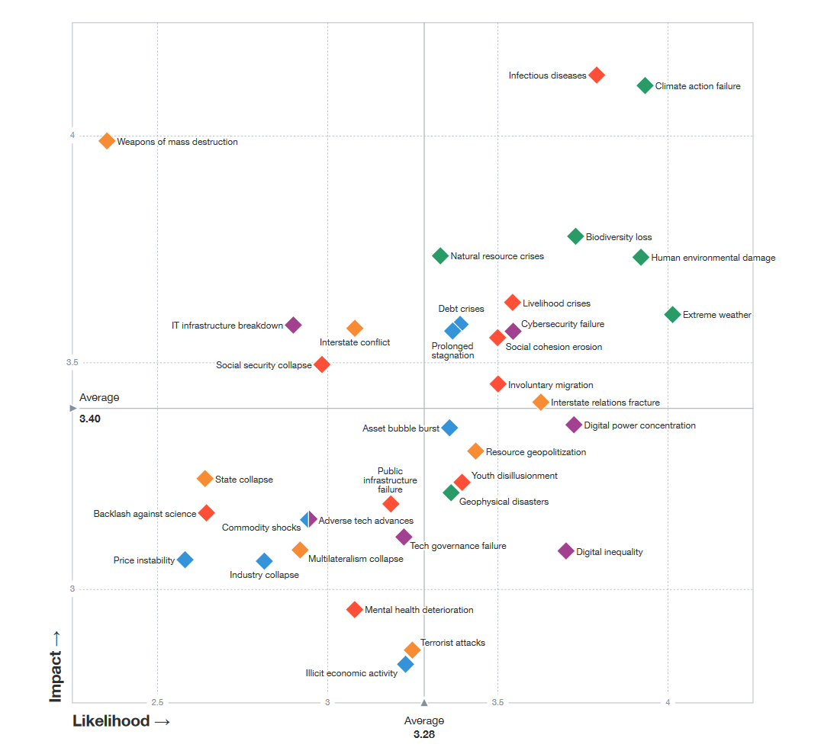
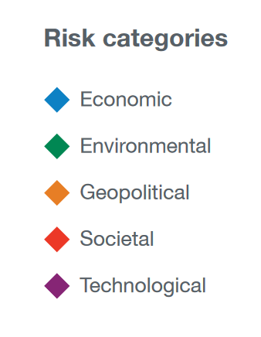
Global Risk Report 2021:
Risk perception
Impact
Infectious diseases
Climate action failure
Weapons of mass destruction
Biodiversity loss
Risks are interconnected
Likelihood

Slide 4
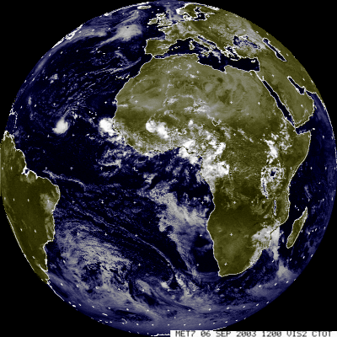
Club of Rome 1972
Global Ecosystem
In a limited system
exponential growth
leads to overshoot
and then to the
collapse of the system.
Meadows et al. 1972

Slide 5
Laudato Si!
„ The pace of consumption, waste and environmental change has so stretched the planet’s capacity
that our contemporary lifestyle, unsustainable as it is, can only precipitate catastrophes“ (161)

Slide 6
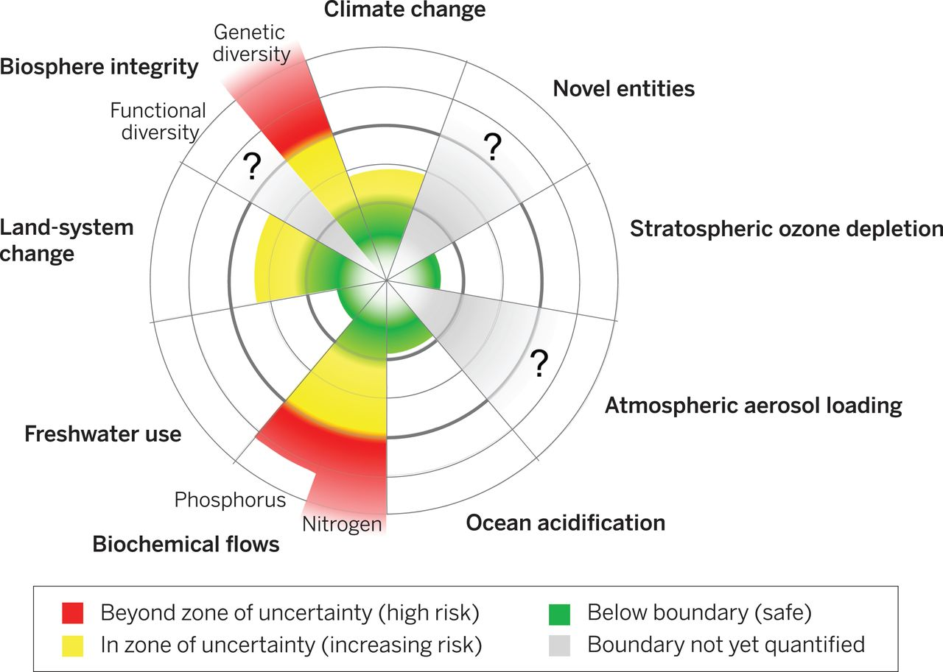
Climate change
Beyond zone of un-certainty (high risk)
Biosphere integrity
Genetic
diversity
In zone of uncertainty (increasing risk)
Novel entities
Fuctional Diversity
Below boundary (safe)
?
?
Boudary ot yet quantified
Land-
system
change
Stratospheric ozone depletion
?
Freshwater use
Phosphorus
Atmospheric ozone loading
Nitrogen
Ocean acidification
Biogeochemical flows
Steffen et al. 2015

Slide 7
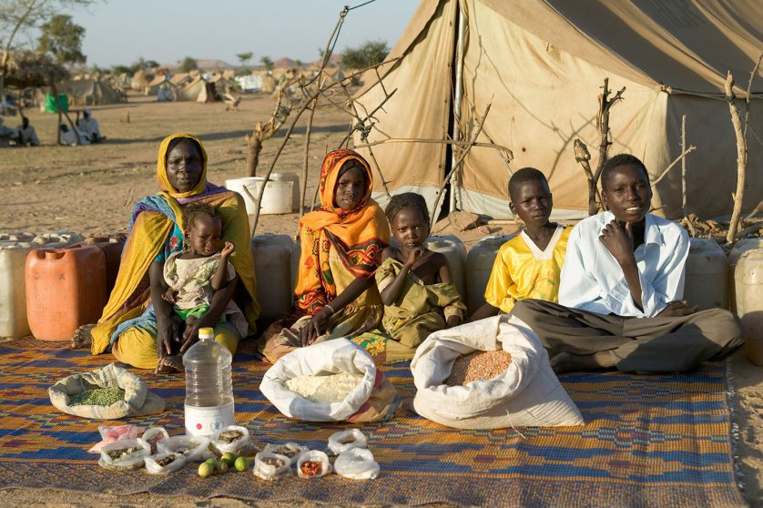
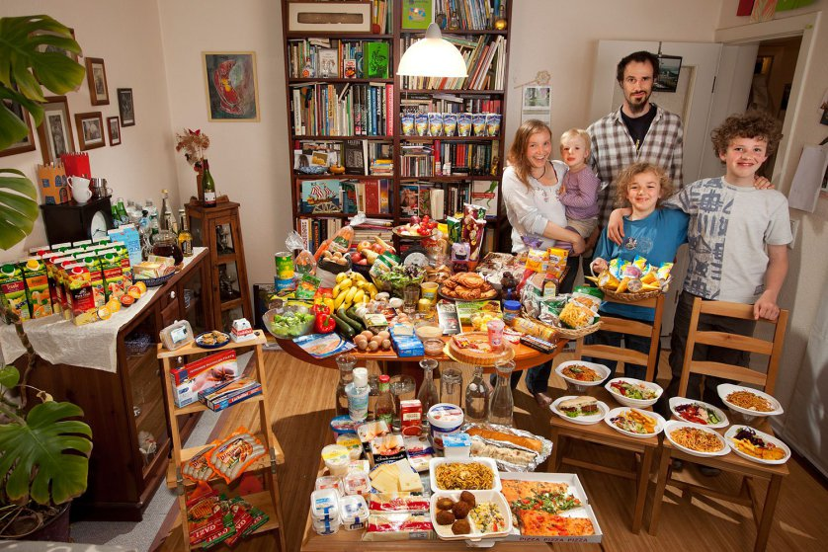
Social aspects: What one family eats in a week
Hungry Planet: What The World Eats. Peter Menzel
Chad
Germany
Hungry Planet: What The World Eats. Peter Menzel
Notes:
Chad: The Aboubakar family of Breidjing Camp. Food expenditure for one week: 685 CFA Francs or $1.23.

Slide 8
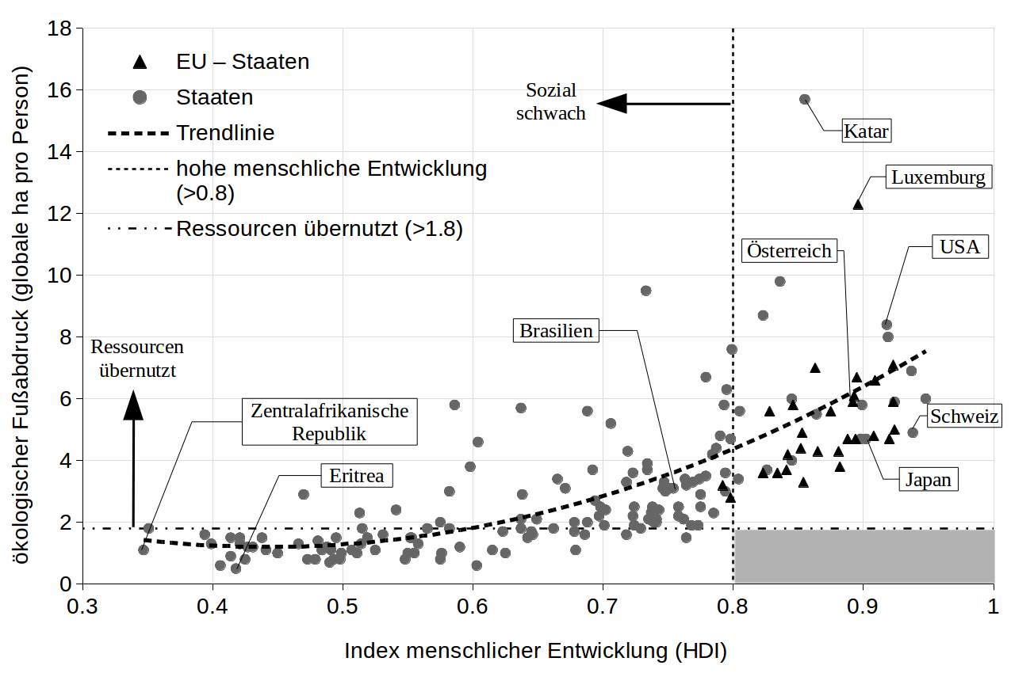
Fight hunger first, then climate change?
Ecological footprint (global ha/person)
Human Development Index (HDI)
Human Development Index (HDI)

Slide 9
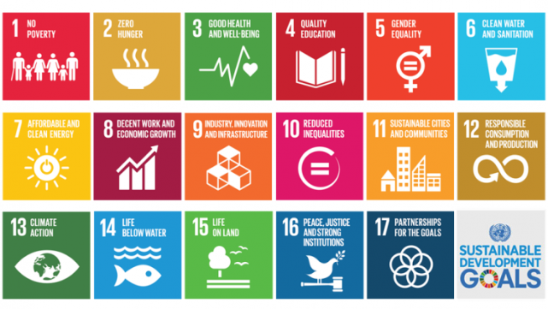
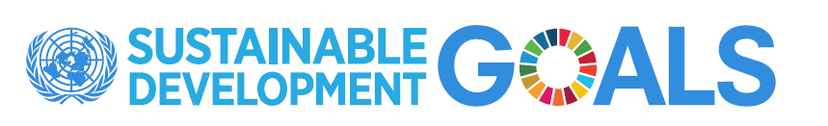
Basically, the SDGs represent two agendas:
  the human security agenda and
  the planetary boundaries agenda
The challenge is to connect these synergistically and avoid competition between them
Riahi, based on Oran Young, UCSB

Slide 10
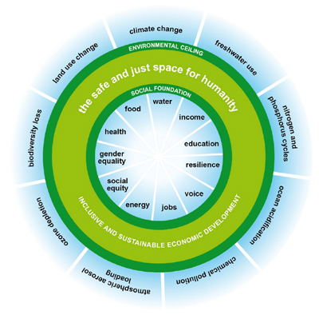
Kate Raworth 2014
Ecological boundaries
Operating space for economy
An economic systems based on growth cannot be sustainable
Social boundaries
Notes:
Ecological dimension of sustainability = basis of our life
Social dimension of sustainability = joy of life
Economic sustainability = but a tool, not an end in itself
Spiritual dimension of sustainability = purpose in life?

Slide 11
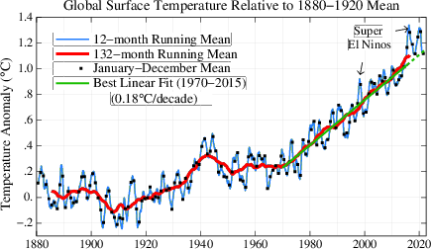
Temperature anomaly (vs.1880 – 1920)
2015 to 2017 El Nino
2019 & 2020
aerosols?
reference period
+1,2°C
(1880-1920)
Hansen et al 2022, complemented
Vorindustrielles Niveau

Slide 12
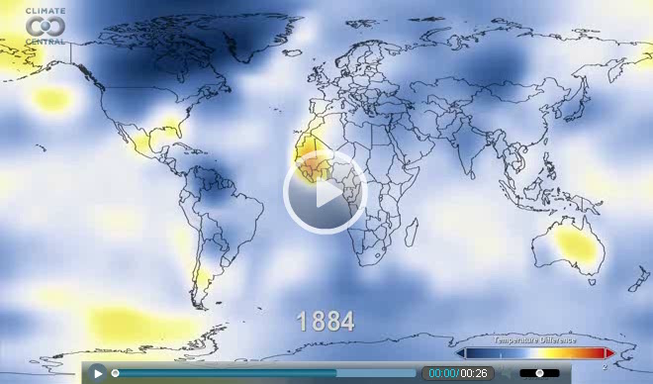
Temperature of the last 131 Years

Slide 13
A short look at climate scenarios
The pessimistic scenario
The alliance between the economy and technology ends up sidelining anything unrelated to its immediate interests. (Laudato Si!; 54)

Slide 14
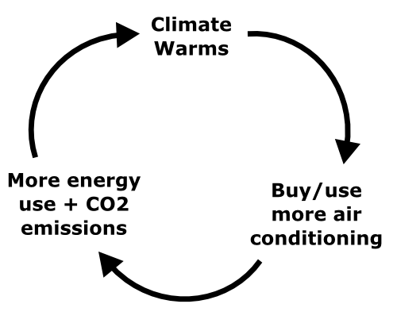
Passing tipping points
Due to enhancing feed back processes in the climate system the likelihood of exceeding tipping points grows
Water vapor
feed back
Ice-Albedo
feed back
humidity rises; warming increases
evaporation from oceans grows
absorption
increases
Ice melts,
surface darkens

Slide 15
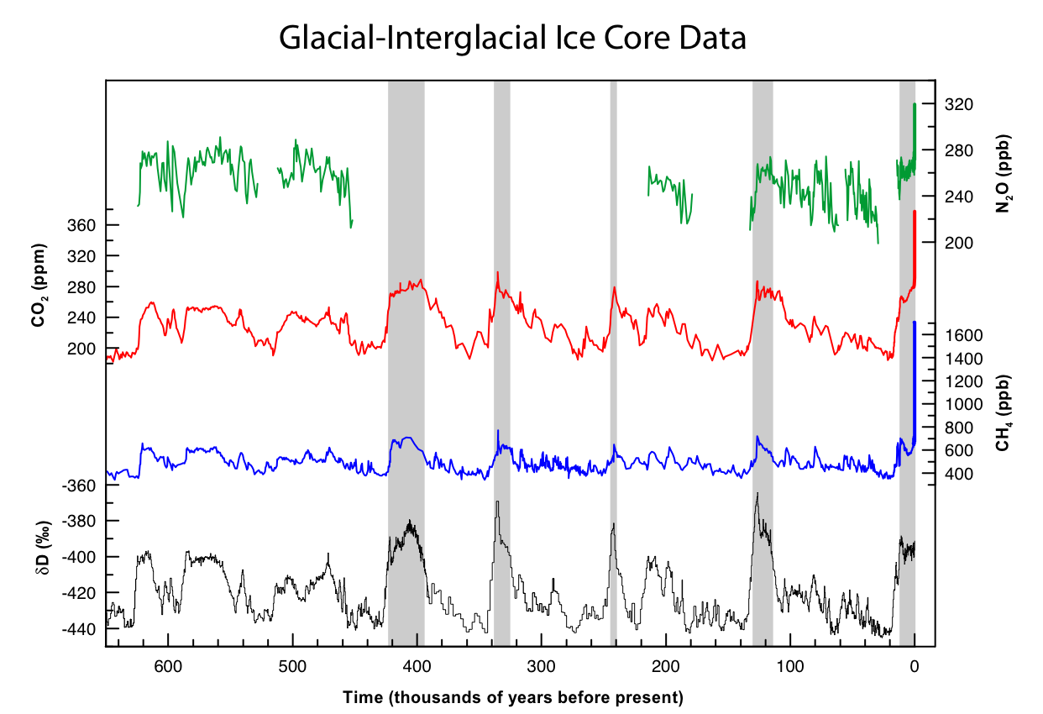
Temperature and GHG Concentrations (ice core data)
415 ppm (2020)
N₂O
400 ppm
CO₂
280 ppm
180 ppm
CH₄
temperature
Warm periods
Ice ages
600.000
0
IPCC 2007, modified

Slide 16
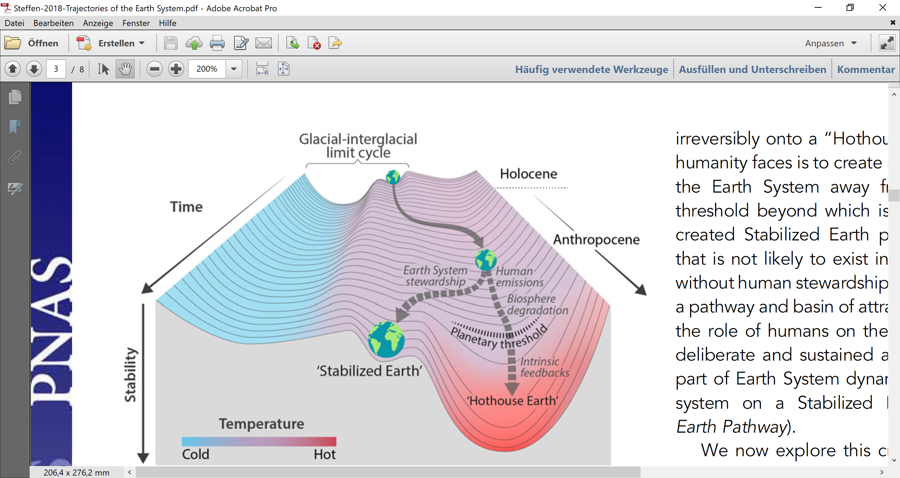
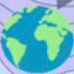
Stability states of the earths climate
Steffen et al. 2018,
strongly simplified
Astronomically induced climate shifts
GHG accumulation over the last 100 years
?
Stability
no evidence in past 500 mio years
No evidence in past 500 mio years
Warm periods
eg. holocene
Ice ages
hothouse earth
colder
hotter

Slide 17
Decision we are taking NOW
Stabilizing climate at 1,5°C or
Not stabilizing it → continuous warming (hot house earth)
1,5°C will be exceeded in the early 2030ies
Measures that take effect this decade are needed
This dimension makes climate issue something special!
(„Tipping points - too risky to bet against“)
Biodiversity of similar urgency, but less well understood.

Slide 18
The optimistic scenario:
The fragile stability path of 1,5°C
The natural environment is a collective good, the patrimony of all humanity and the responsibility of everyone.
(Laudato Si!; 95)

Slide 19
Climate at +1,5°C
Max. temp. in Europe +3-4°C, present day extremes = normals
Summers like 2003 every 2-3 years,
700 mio people under heat stress
2,6 month of drought / year in central Europe,
3,7 in the mediterranean area
4 mm /a increase of sea level;
500 year floods → 100 year floods
70-90% of all coral reefs endangered
.......
Even at +1,5°C the climate will not be pleasant
IPCC SR15 (2018)

Slide 20
Climate at +1,5°C is a challenge, but ….
Climate will have stabilised and
we can adapt (IPCC 2022)
To achieve necessary emission reductions,
social and economic conditions can have significantly improved.

Slide 21
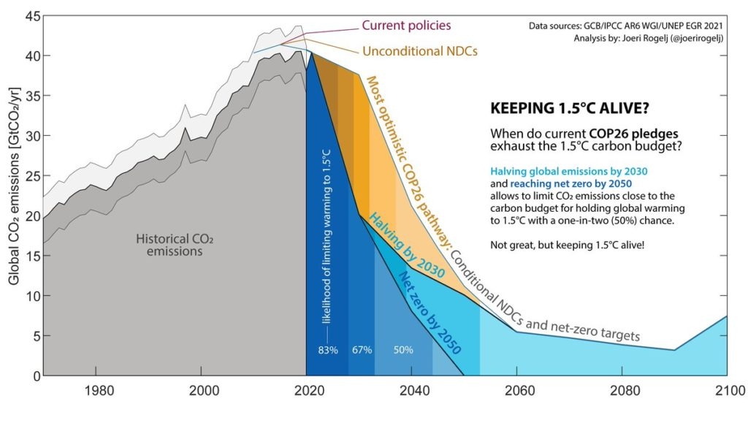
Halving emissions by 2030 and reaching net zero by 2050
→ keeping within 1,5°C with 50% likelihood
Budget exhausted by 2050

Slide 22
Necessary measures
Incentives within economic system
Replace fossile energy by renewable energy.
(technology)
Increase efficiency – similar service with
less energy and other ressources.
(technology and life style)
Focus on sufficiency – make do with less.
(mindset and life style)

Slide 23
„ …. full transformation of our economy“
(A. Merkel, 2021.07.15)
Energy → geopolitics more peaceful, money remains in communities, incentives to new thinking, ..
Industry → durable products, repair economy, possession --> rental, ...
Mobility → improved health and safety, ...
Infrastructure → flexible, adaptive, climate friendly, ...
Agriculture → resilient, healthy foods & soils, ...
Health system → preventive medicine, health promotion, ...
Education → fosters creativity, cooperation, ...
Economic system → circular eonomy, no growth paradigm, ….
Financial system → serves real economy, biotope of currencies, ....
Democracy → participation, ethics of responsibility, LNB, …

Slide 24
Change the way of thinking; integrated solutions
“Ecological culture cannot be reduced to a series of urgent and partial responses to the immediate problems of pollution, environmental decay and the depletion of natural resources.
There needs to be a distinctive way of looking at things, a way of thinking, policies, an educational programme, a lifestyle and a spirituality which together generate resistance to the assault of the technocratic paradigm.
Otherwise, even the best ecological initiatives can find themselves caught up in the same globalized logic.” (Laudato Si!; 111)

Slide 25
Change the system
“To seek only a technical remedy to each environmental problem which comes up is to separate what is in reality interconnected and to mask the true and deepest problems of the global system.“ (Laudato Si!; 111)
If solutions are so impossible to find within the system, then maybe we should change the system. (Greta Thunberg)

Slide 26
Necessities rather than options
„As long as we focus on what is politically possible instead of what is necessary, there is no hope.
(Greta Thunberg 2018)
© Gregor Hagedorn, CC BY-SA 4.0, Quote by Greta Thunberg.
Notes:
SPEAKER_NOTES:
VARIANT: GERMAN
CREDITS: © Gregor Hagedorn, CC BY-SA 4.0, Quote by Greta Thunberg.
NOTES: Originaltext: “Until you start focusing on what needs to be done, rather than what is politically possible, there is no hope.
If solutions within the system are so impossible to find, then maybe we should change the system itself.”
SOURCES: Speech as COP Katowice 2018, via twitter, e.g.
https://twitter.com/SenSanders/status/1073701026660843520
https://twitter.com/GretaThunberg/status/1073527918616297472
See also 4.05 m video of the speech: https://www.youtube.com/watch?v=HzeekxtyFOY
REVIEWED_BY:

Slide 27
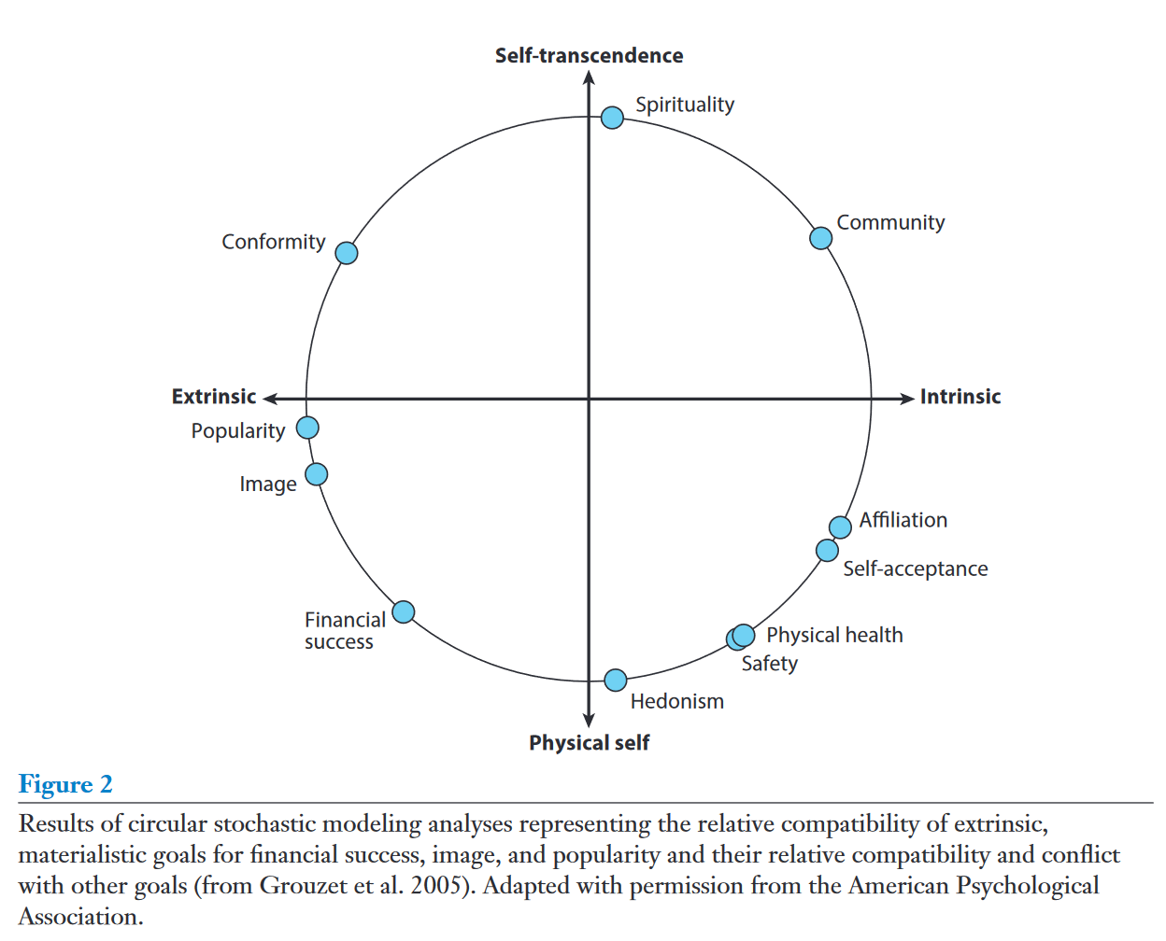
Change of minds and hearts: rate intrinsic over extrinsic values
Value circumplex
Kasser 2016

Slide 28
Shift in values
Hedonistic and extrinsic values are nurtured by present economic and societal systems
Self-transcendant and intrinsic values are embedded in very world religion
By adressing values, you strengthen them.
By giving hope you, you strengthen them.
Religions should not be afraid of addressing the values they stand for → transformation will not happen without shift of values!

Slide 29
Thank you for your attention!
Em. Univ. Prof. Dr. Helga Kromp-Kolb
University of Natural Resources and Life Sciences, Vienna
Institute of Meteorology and Climatology
and
Center for Global Change and Sustainability
Daenenstrasse 4, A-1190 Wien
Tel.: +43 664 325 9704
helga.kromp-kolb@boku.ac.at, www.boku.ac.at

Slide 30
Enzyklika „Laudato Si!“
(Juni 2015)
aktuelle Lebensweise der Menschheit … „selbstmörderisch“
An outsider looking at our world would be amazed at such behaviour, which at times appears self-destructive. (55)
„Rhythmus des Konsums, der Verschwendung und der Veränderung der Umwelt hat die Kapazität des Planeten derart überschritten, dass der gegenwärtige Lebensstil nur in Katastrophen enden“ könne (161)
The pace of consumption, waste and environmental
change has so stretched the planet’s capacity that our contemporary lifestyle, unsustainable as it is, can
only precipitate catastrophes

Slide 31
Enzyklika „Laudato Si!“
(Juni 2015)
Dominanz der Wirtschaft / Finanzwirtschaft gegenüber der Politik, verhindere wirksamen Umweltschutz
Unterwerfung der Politik unter die Technologie und das Finanzwesen zeige sich in Erfolglosigkeit der Weltgipfel über Umweltfragen. (54)

Slide 32
Der Papst publiziert Enzyklika „Laudato Si!“ (Juni 2015)
Die Umwelt ist ein kollektives Gut, ein Erbe der gesamten Menschheit und eine Verantwortung für alle. (95)
The natural environment is a collective good, the patrimony of all humanity and the responsibility of everyone. (95)
ohne den Druck der Bevölkerung wird es keinen Fortschritt in diesen Fragen geben.

Slide 33
Die ökologische Kultur kann nicht reduziert werden auf eine Serie von dringenden Teilantworten auf die Probleme, die bezüglich der Umweltschäden, der Erschöpfung der natürlichen Ressourcen und der Verschmutzung auftreten. Es müsste einen anderen Blick geben, ein Denken, eine Politik, ein Erziehungsprogramm, einen Lebensstil und eine Spiritualität, die einen Widerstand gegen den Vormarsch des technokratischen Paradigmas bilden. (111)

Slide 34
Enzyklika „Laudato Si!“
(Juni 2015)
unvertretbar, dass einige immer mehr konsumierten und zerstörten, während andere noch nicht entsprechend ihrer Menschenwürde leben könnten

Slide 35
The alliance between the economy and technology ends up sidelining anything unrelated to its immediate interests. Consequently the most one can expect is superficial rhetoric, sporadic acts of philanthropy and perfunctory expressions of concern for the environment, whereas any genuine attempt by groups within society to introduce change is viewed as a nuisance based on romantic illusions or as an obstacle to be circumvented.(54)

Slide 36
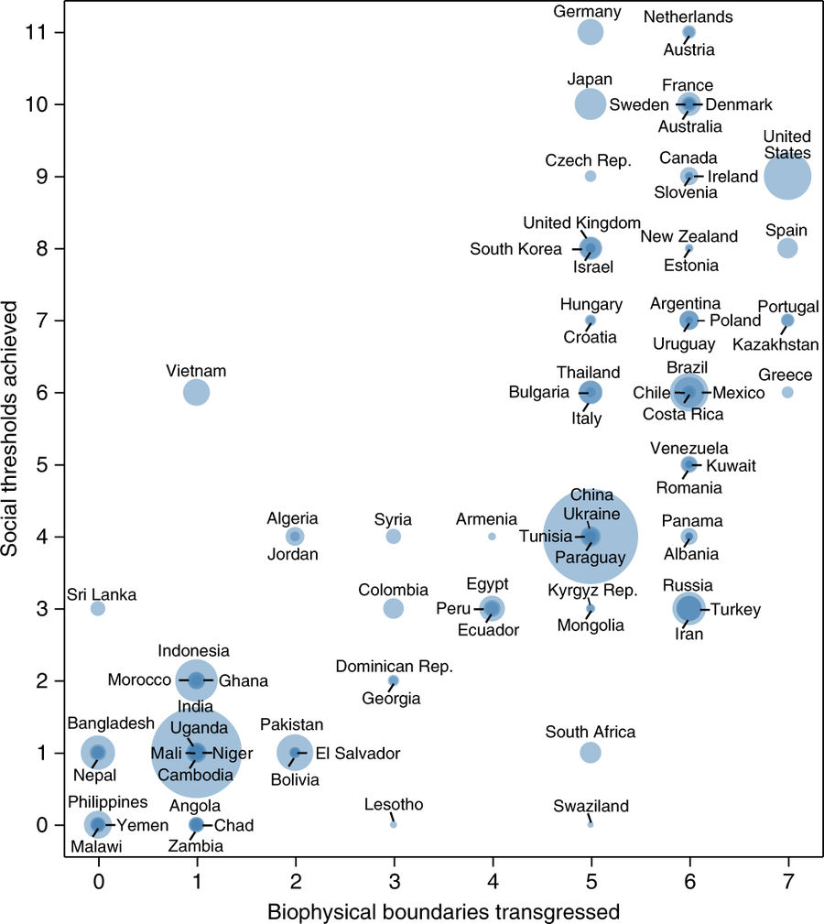

Slide 37
Global land area and area used for food production
© Hannah Ritchie & Max Roser, OWID, CC BY-SA 4.0, based on data by FAO and World Bank Statistics, https://ourworldindata.org/yields-and-land-use-in-agriculture .
Fläche
29 % Land
149 Mio. km²
71 % Oceans
361 Mio. km²
Surface of the Earth
71 % Inhabitable Land
104 Mio. km²
10 % Glaciers
15 m km²
19 %
Unfertile Land
28 Mio. km²
Land surface
50 % Agriculture
51 Mio. km²
37 % Forrests
39 Mio. km²
11 % Bush
12 Mio. km²
Wohnfläche
Landwirtschaftliche
Nutzfläche
77 % LIvestock
40 Mio. km²
23% Plants for food
not feed
11 Mio. km²
1%
Settlements
1.5m km²
1%
Fresh water
1.5m km²
33% of proteins, 17% of calories
Notes:
VARIANT: GERMAN
CREDITS: © Hannah Ritchie & Max Roser, OWID, CC BY-SA 4.0, based on data by FAO and World Bank Statistics, https://ourworldindata.org/yields-and-land-use-in-agriculture, modified and translated by Catherine Eckenbach, CC-BY-SA 4.0.
SOURCE: This image direct: https://ourworldindata.org/wp-content/uploads/2013/10/Land-use-graphic-01-01-01.png

Slide 38
Monbiot: Who may challenge the system?
If you are middle class, they call
you a champagne socialist.
If you are working class, they say it's the politics of envy.
If you wear leather shoes, they call you a hypocrite.
If you don't, they call you a hippy.
Everyone, apparently, is disqualified from challenging the system
Notes:
https://www.youtube.com/watch?v=LLdxWjEWCrk

Slide 39
Change the system
The failure of global summits on the environment make plain that our politics are subject to technology and finance. There are too many special interests, and economic interests easily end up trumping the common good and manipulating information so that their own plans will not be affected (Laudato Si!; 54)
If solutions are so impossible to find within the system, then maybe we should change the system. (Greta Thunberg)

Slide 40
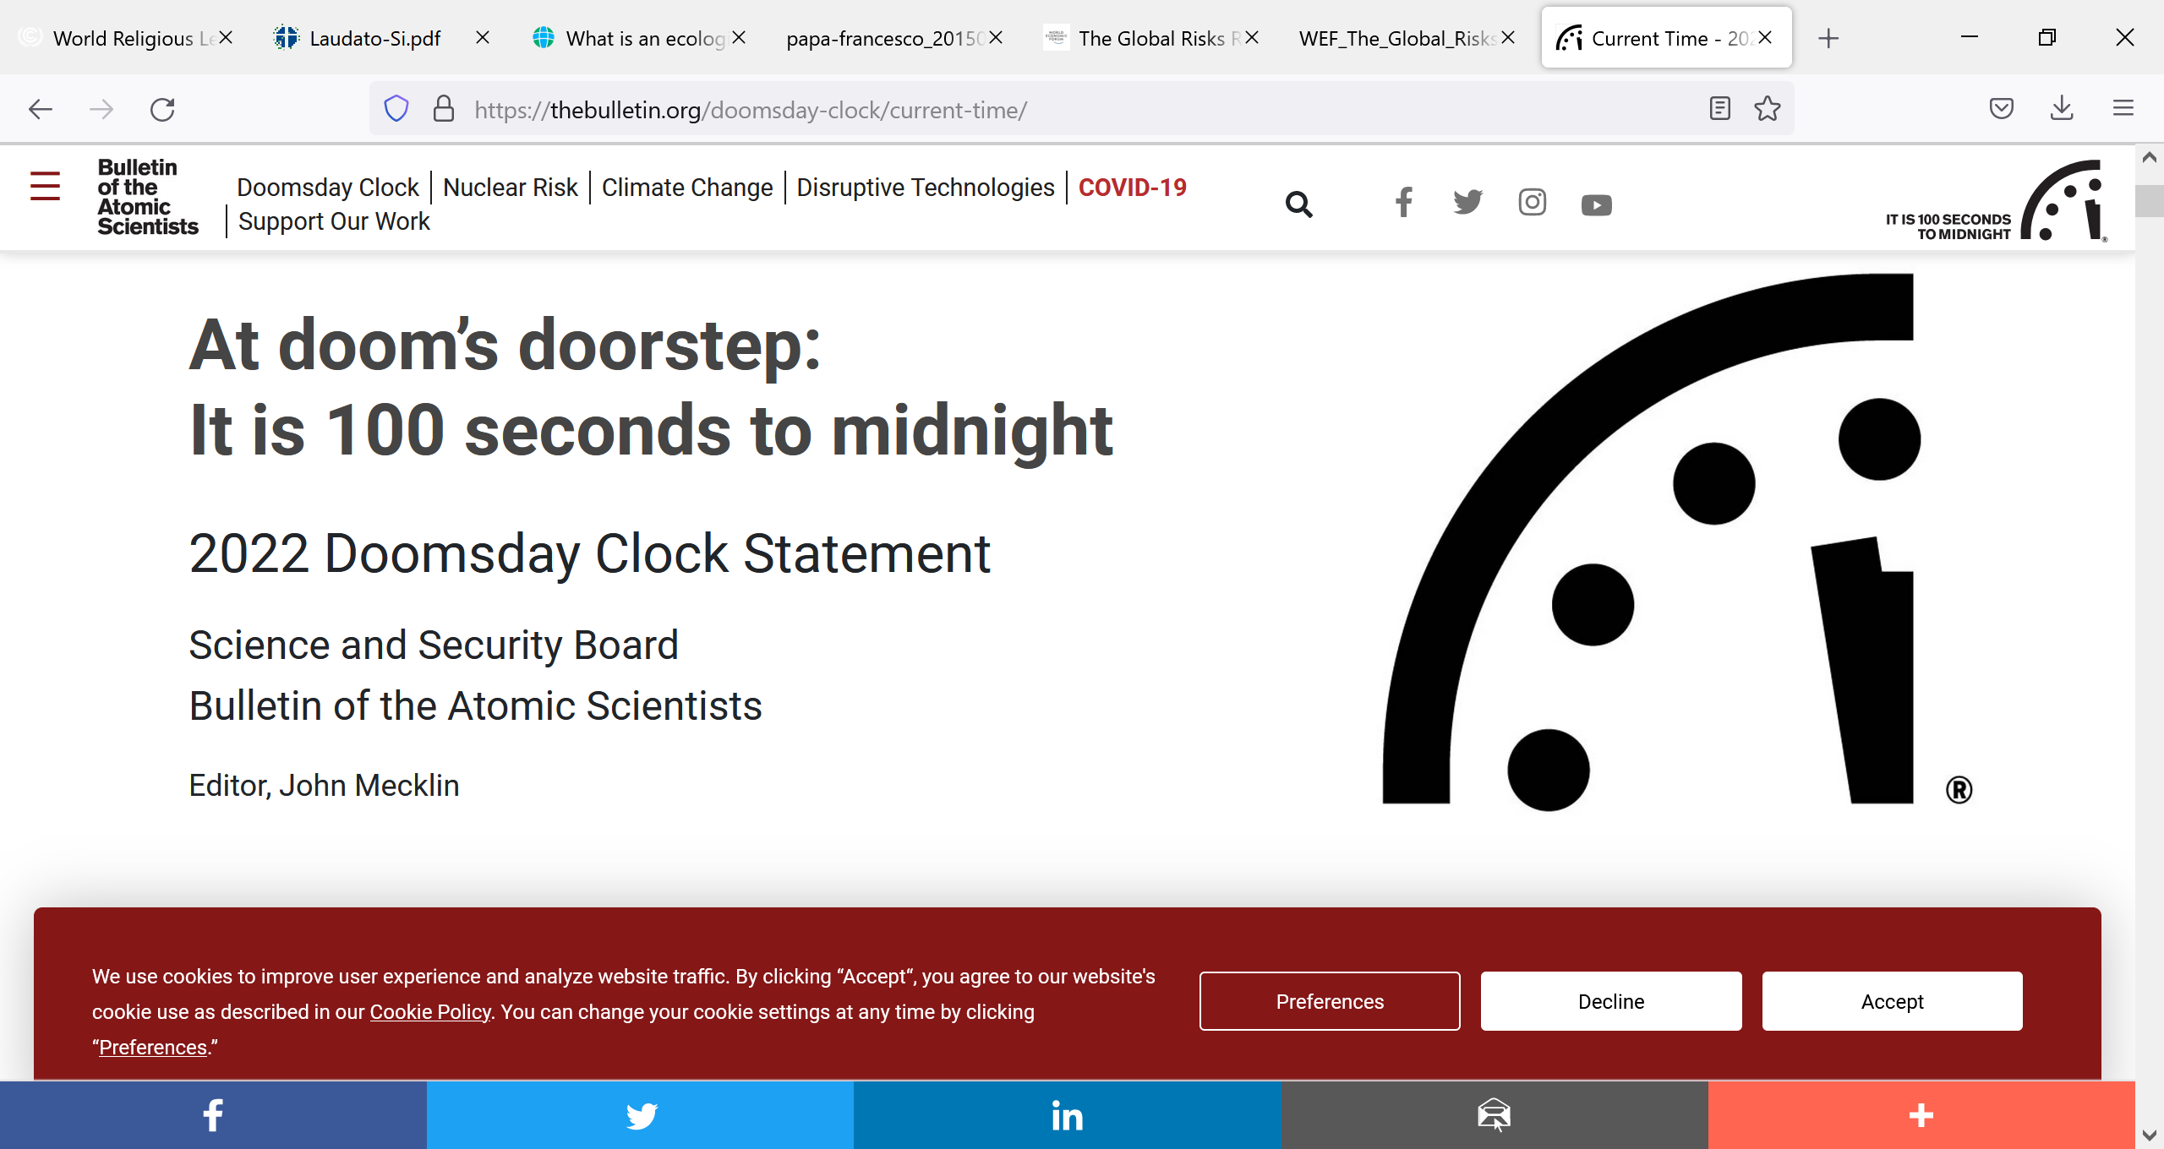
Noam Chomsky
Two issues could mean the end of organised human life on earth:
  Climate Change and
  Nuclear War
Doomsday Clock (2022)
… Without swift and focused action, truly catastrophic events—events that could end civilization as we know it—are more likely. When the Clock stands at 100 seconds to midnight, we are all threatened. The moment is both perilous and unsustainable, and the time to act is now.

Slide 41
Dimensions of Sustainability
Ecological dimension of sustainability = basis of our life
Social dimension of sustainability = joy of life
Economic sustainability = but a tool, not an end in itself
Spiritual dimension of sustainability = purpose to life
The alliance between the economy and technology ends up sidelining anything unrelated to its immediate interests. (Laudato Si!; 54)

