Slide 1
Addressing the demographic challenges by strengthening families Balázs Molnár

Slide 2
Demographic Winter in the EU
EU is loosing economic and political relevance in the World due to declining population
- Population: 1960-20%; 2020-10%; 2070-6%
- Economic strength: 2008-28%; 2014-16%
No single Member State has enough births for the renewal
Ageing- sustainability – health care- workforce
Children are invisible, adults only culture
Demographic challenges are reticenced

Slide 3
Demographic Winter in the EU
Parents are only seen as workforce missing out; motherhood, childrearing not valued
Charges against the traditional family, the basic building block of any society
Relativisation of marriage between one woman and one man, but! constant push for same sex marriage
Churches representing eternal values condemned, some already give in…
Abortion seen as the peak of women’s rights

Slide 4
Old-age-dependency ratio in EU27 and in Hungary (%)
Source: Eurostat

Slide 5
Culture of loneliness - Proportion of people over 65 by type of household, 2020
Source: Eurostat

Slide 6
„Due to the impending climate catastrophe, it is not worth giving birth to a child"
NEGATIVE answers
2021 ELFAC
2021 NOE
2020 KINCS research
71%
86%
69%
Hungarians were the least able to identify themselves with the statement that it is not worth bringing a child into this world because of the climate catastrophe, but other large European families also strongly reject such a linkage between having a child and the environmental catastrophe

Slide 7
Successful demographic policies
Strengthening communities vs individualism
Helping young Europeans to decide for family and children with decent employment, housing and prospects
Address prolongation of childbirths
Reconciliation of work and family with focus on the family
No one size fits all solution respect for traditional, cultural and religious specifities- EU no melting pot
Intergenerational solidarity – mutually important for both elderly, parents and grandchildren

Slide 8
Changes in the number of women aged 20-39 and over 60 in Hungary (January 1, 2000-2020)
Women aged 60 and older
Women aged 20-39
Source: Central Statistical Office
The number of 20-39 year olds showed an increase until 2007, then we can see a sharp decrease End of the 2nd "Ratkó-Generation").
The impact of aging societies and increasing life expectancy can be seen in the intense increase in the number of women over the age of 60.

Slide 9
Development of marriages in Hungary (1941-2020)
Source: Central Statistical Office
2021 - preminilary data
In 2020, the number of marriages continued to rise, 3.1% more couples have decided to tie the knot compared to in 2019, despite restrictions caused by the coronavirus
Since 1986, the number of marriages has not been as high as in 2020
Between 2010 and 2020, the number of marriages almost doubled, increasing by 89.5%
In 2021 the number of marriages reached 72 000

Slide 10
Changes in the number of divorces in Hungary (1941-2020)
Source: Central Statistical Office
In 1987, the number of divorces in the country was remarkably high, at which time 29,856 couples divorced
The number of divorces is at a six-decade low, last it was back in 1962 when less couples have divorced

Slide 11
Changes in the number of abortions and live births in Hungary (1950-2020/2021)
Abortions
Live births
Source: Central Statistical Office
The number of abortions has dropped by 36% in the last decade, it has last been less in 1954
Today, there was one abortion for every four live births today, and in the 2000s there was one abortion for every three live births

Slide 12
Humanitarian crisis- war in Ukraine
Millions of people fleeing the country
Mostly families: women with children, elderly
260 000+ arrived to Hungary already
Christian Aid organization working in the first rows
Caritas providing food, shelter, and a shoulder to rely on

Slide 13
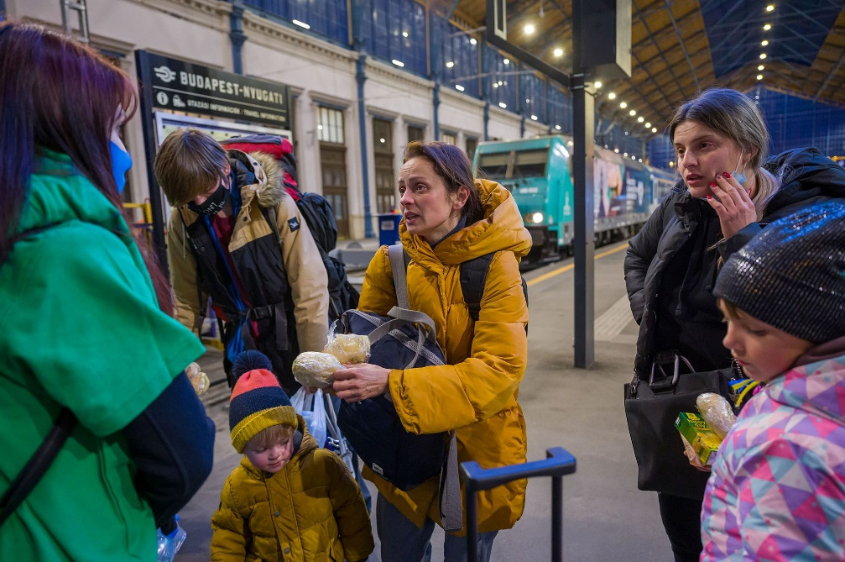
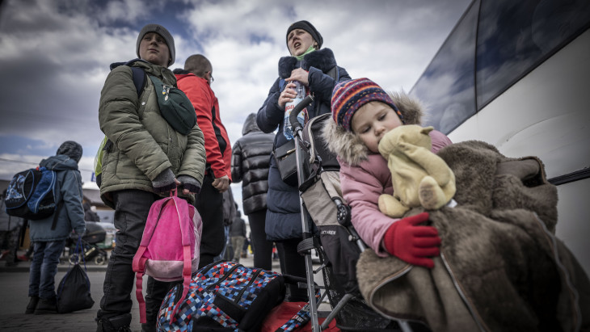
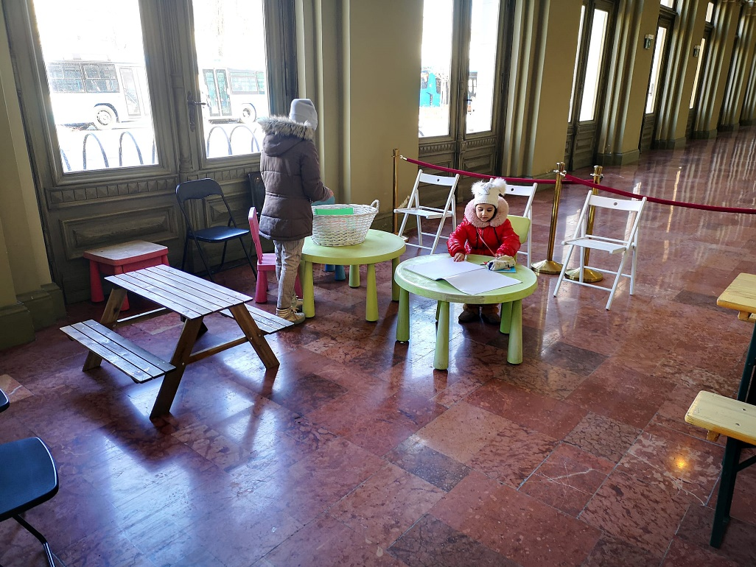
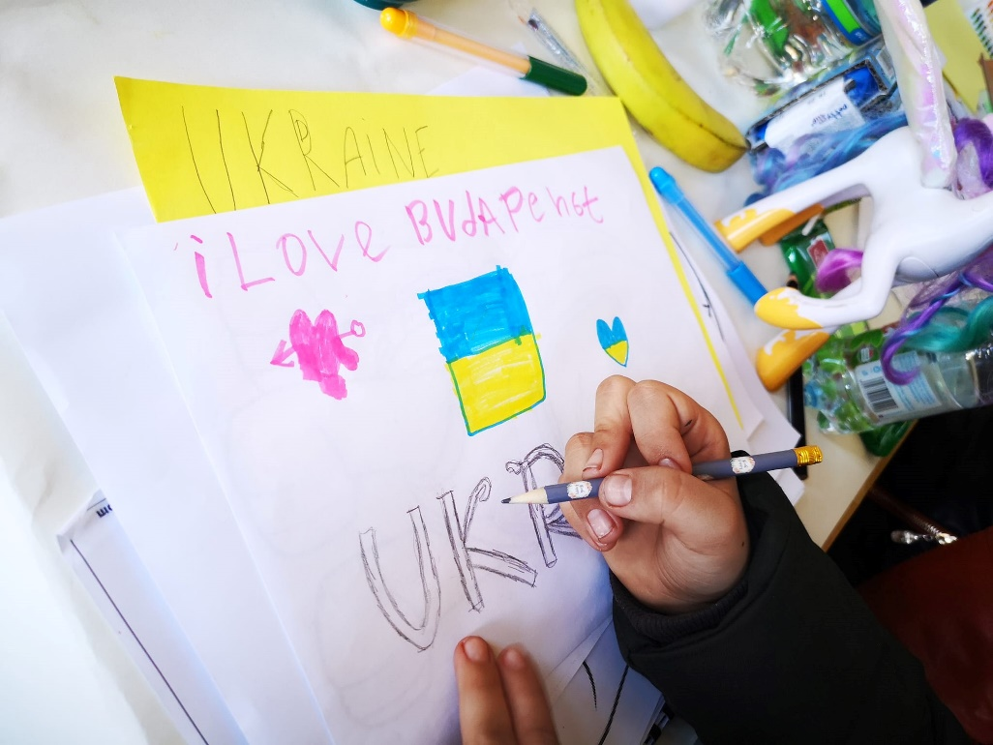

Slide 14
Thank you for your kind attention!
www.koppmariaintezet.hu/en

